Slide 1

CyberShield System
OOP PROJECT
A cybersecurity system designed with OOP principles
Prepared by: Sultan Khalid Al Yarabi, Malik Marzooq Al Rahbi, Khamis Hamed Alowaisi, Mohammed Naeem Al Gheilani
A' Sharqiyah University

Slide 2
INTRODUCTION
CyberShield is a cybersecurity system developed using Object-Oriented Programming principles. The system is designed to simulate a one-person company that is fully managed by a single founder, streamlining operations and decision-making processes.
Digital agents are at the core of CyberShield, assisting the founder in performing various cybersecurity tasks efficiently. These intelligent agents work collaboratively to detect threats, identify vulnerabilities, and suggest appropriate responses to security challenges.

Slide 3
SYSTEM IDEA
The CyberShield system operates through a streamlined workflow:
• Founder creates cybersecurity tasks (e.g., system security check)
• Tasks are delegated to multiple digital agents for analysis
• Each agent analyzes the task according to its specialized role
• Founder reviews all agent results and makes the final decision
This approach ensures comprehensive security assessment through collaborative agent processing.

Slide 4
AGENTS OVERVIEW
Threat Agent:
Detects suspicious activities within the system
Vulnerability Agent:
Identifies system weaknesses and vulnerabilities
Response Agent:
Suggests solutions to improve overall security

Slide 5
UML DIAGRAM
The UML diagram illustrates relationships among Founder, Task, and Agent classes. The Founder creates tasks and makes final decisions, while Tasks are processed sequentially through three specialized agents.
Flow: Founder → Create_task() → Task → process(task) through ThreatAgent, VulnerabilityAgent, ResponseAgent → decision() → makeDecision() by Founder.
This structure demonstrates clear separation of responsibilities.

Slide 6
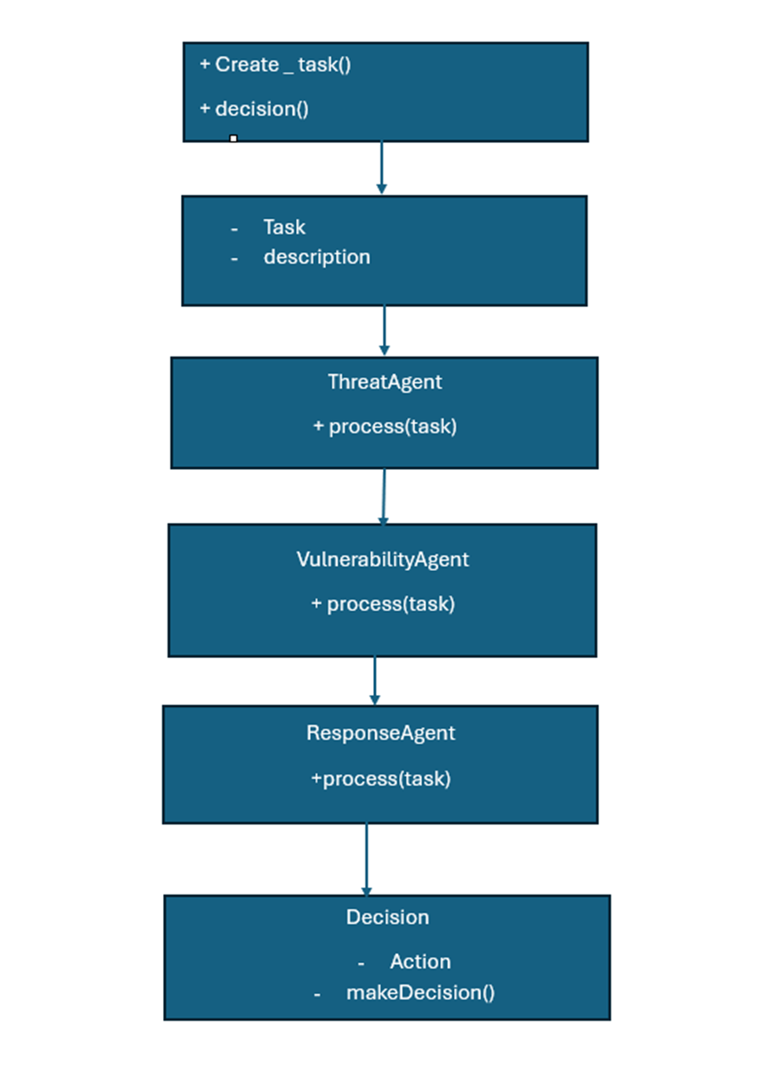

Slide 7
CODE STRUCTURE
Main Classes
Key Functions
The system consists of five core classes: Founder, Task, ThreatAgent, VulnerabilityAgent, and ResponseAgent. Each class encapsulates its own data and behavior, demonstrating OOP encapsulation principles.
Each Agent class implements the process() method to analyze tasks, showcasing polymorphism. The Founder class uses decision() to finalize actions based on agent feedback, demonstrating inheritance and method overriding.

Slide 8
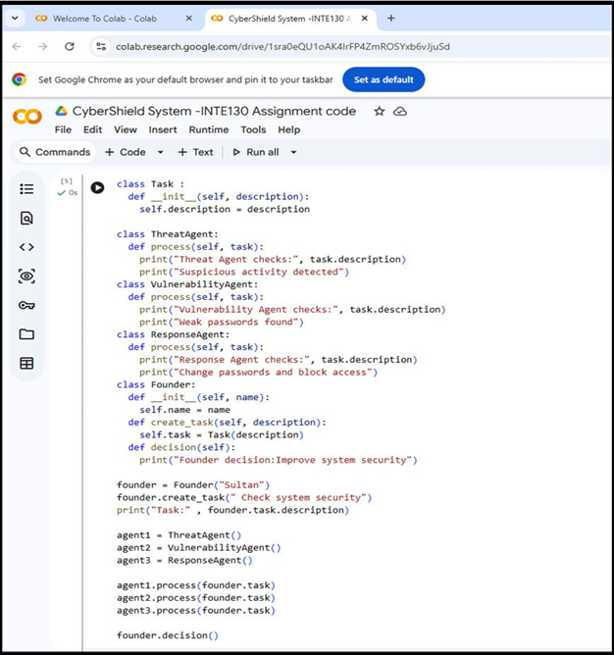

Slide 9
OUTPUT EXAMPLE
Task Input
"Check system security"
Threat Agent
"Suspicious activity detected"
Vulnerability Agent
"Weak passwords found"
Response Agent
"Change passwords, block access"

Slide 10
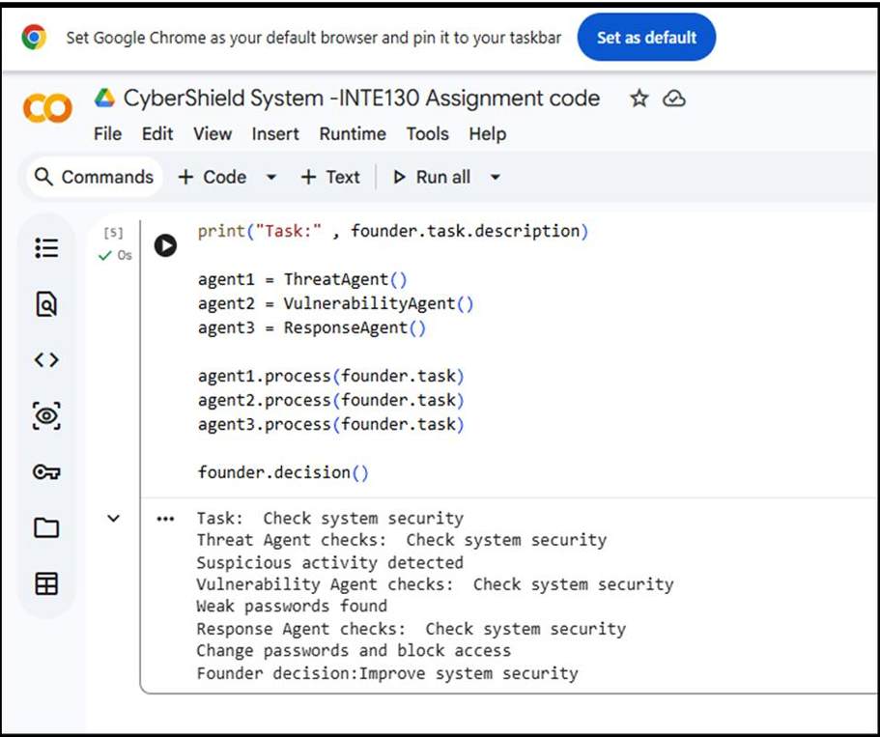

Slide 11
CONCLUSION
The CyberShield System demonstrates the practical application of Object-Oriented Programming concepts in cybersecurity. Our multi-agent architecture simplifies complex task management for a single user, enabling effective detection and response to security threats.
The system provides a foundation for future enhancements, including additional specialized agents, expanded threat detection capabilities, and integration with real-world security tools. This project showcases how OOP principles create scalable, maintainable solutions.

Slide 12
THANK YOU
CyberShield Team - A' Sharqiyah University
We welcome your questions and feedback

